Slide 1
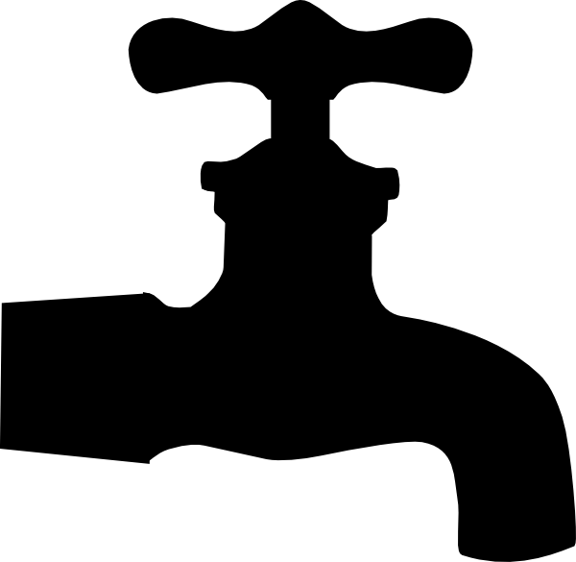
P peline
The Data
How do we go from data set to question?
And from question to data set?
© Jennifer Mankoff & Nikola Banovic
The Data Pipeline; HCII; Spring 2017

Slide 2
But first!
From last lecture:
Syllabus Details

Slide 3
Grading
10% Class Participation
40% Project Bytes [peer graded]
40% Full Projects (there are two)
10% Final Exam

Slide 4
Other details
Large class, small staff (just Nikola + I)
Hence, requirement for peer grading
Peer grades due 2 days after assignment
Penalty for not grading

Slide 5
But first!
From last lecture:
Byte 1 due Monday 1/23
Byte 3 install due Tuesday 1/24

Slide 6
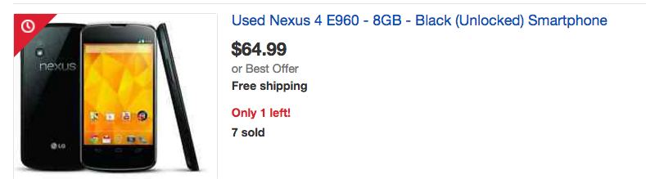
Byte 3 (2 weeks)
Your own data; custom visualization
INSTALL DUE TUESDAY
REQUIRED HARDWARE: Android or iPhone
See Byte 3 in Assignments

Slide 7
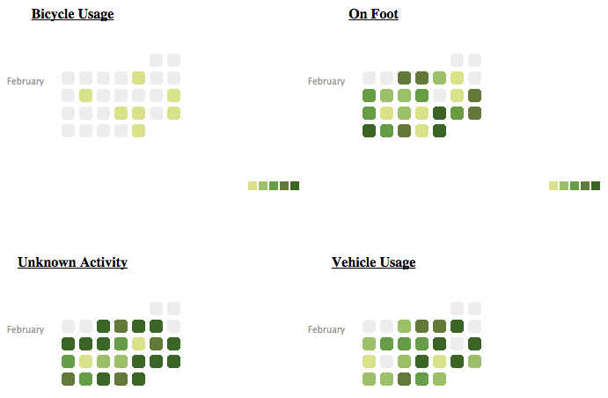
Activities by Time

Slide 8
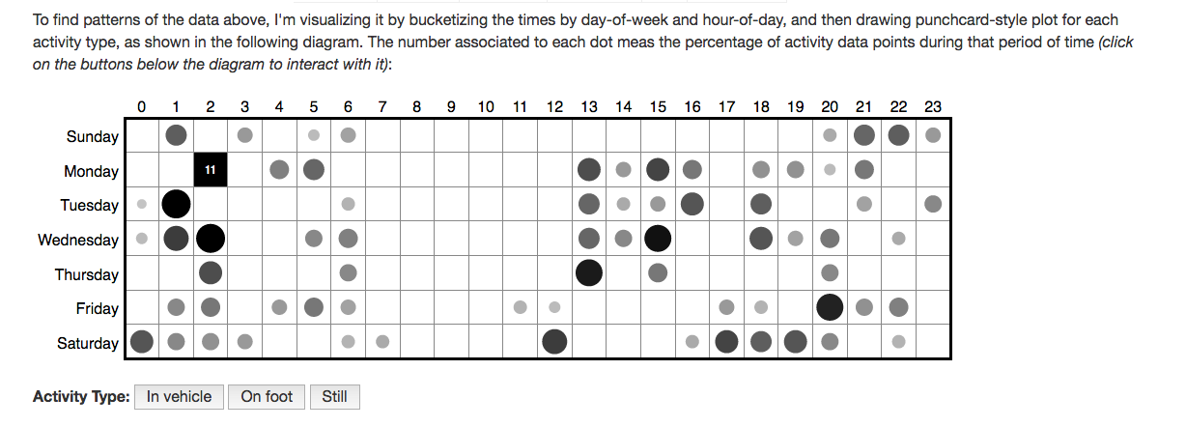
Custom Interactive Viz: Mobility by Time and Day
http://yimmy-mobile.appspot.com/

Slide 9
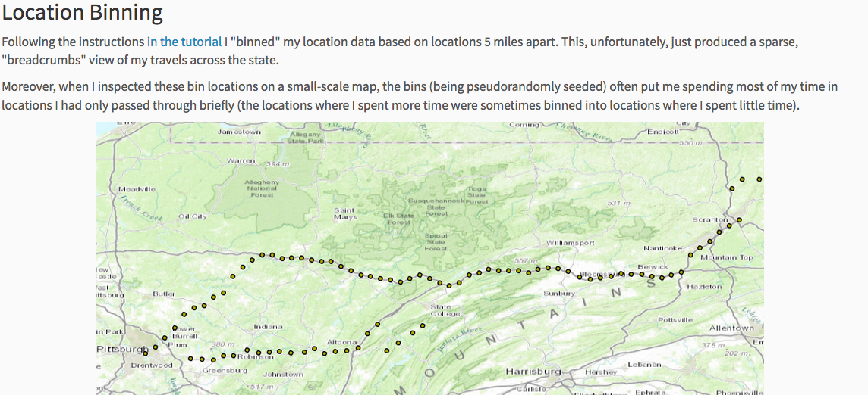
Location Binning
http://mark-where-and-what.appspot.com/

Slide 10
But first!
From last lecture:
Byte 1 due Monday 1/23
Byte 3 install due Tuesday 1/24
Questions about Bytes, Projects, and Grading?

Slide 11
Goals (for this lecture)
After this, you should be able to:
Understand the elements of the data pipeline as they play out in a case study
Be able to point to some pitfalls where things can go wrong in the data pipeline
Be able to explain how the question being answered affects the rest of the pipeline
Adapted from http://www.fordham.edu/economics/Vinod/correl-regr.ppt

Slide 12
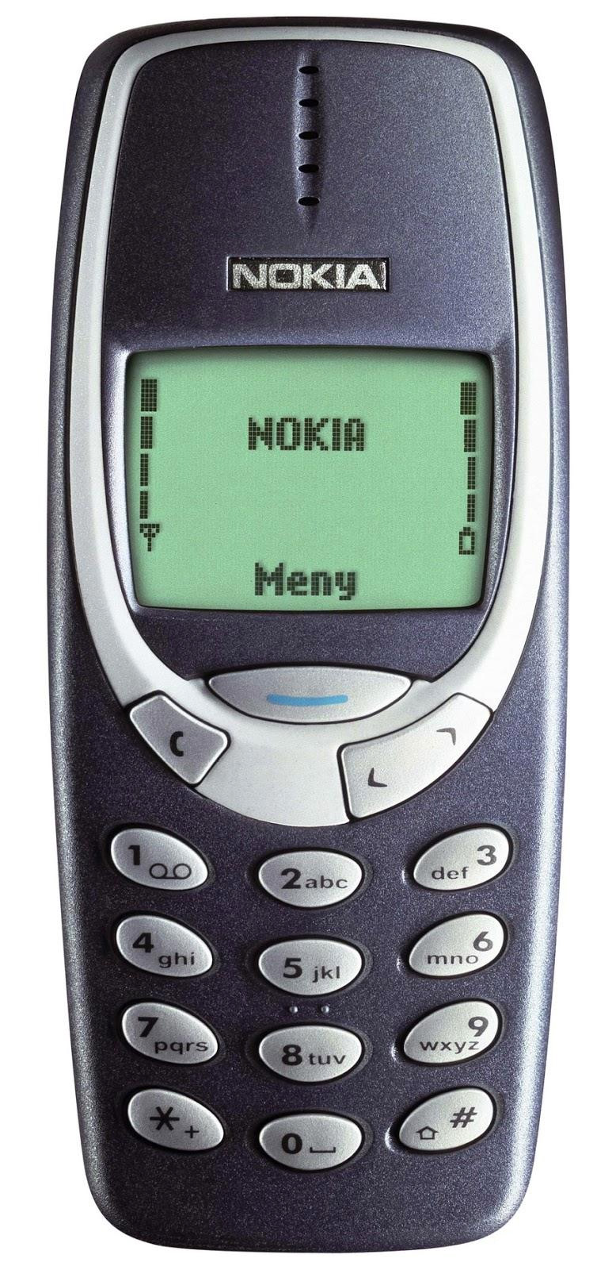
Notes:
Does anybody even remember what this is? ☺

Slide 13
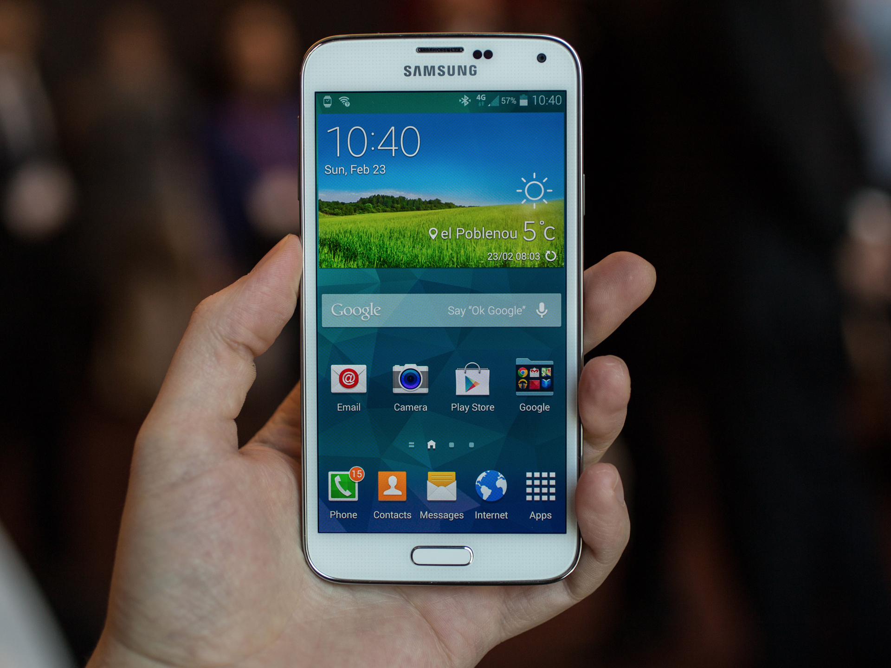
?
Notes:
Why should we care about smart phones?
What questions would you ask?

Slide 14
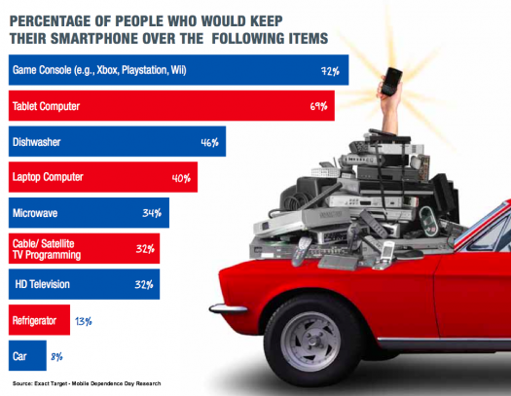
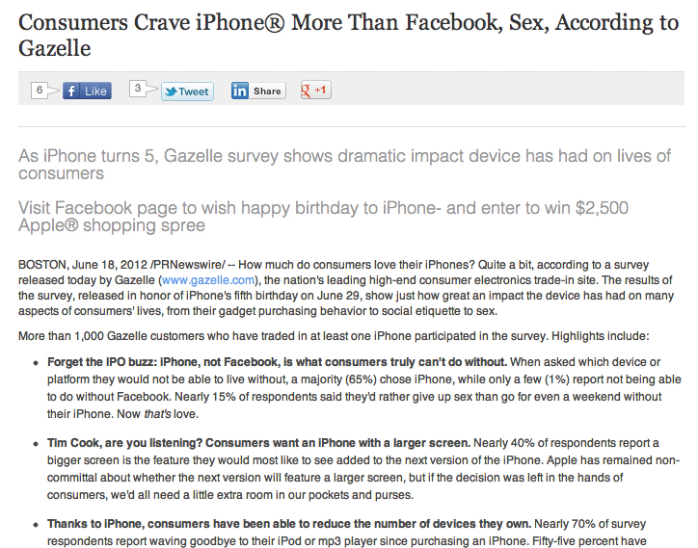

Slide 15
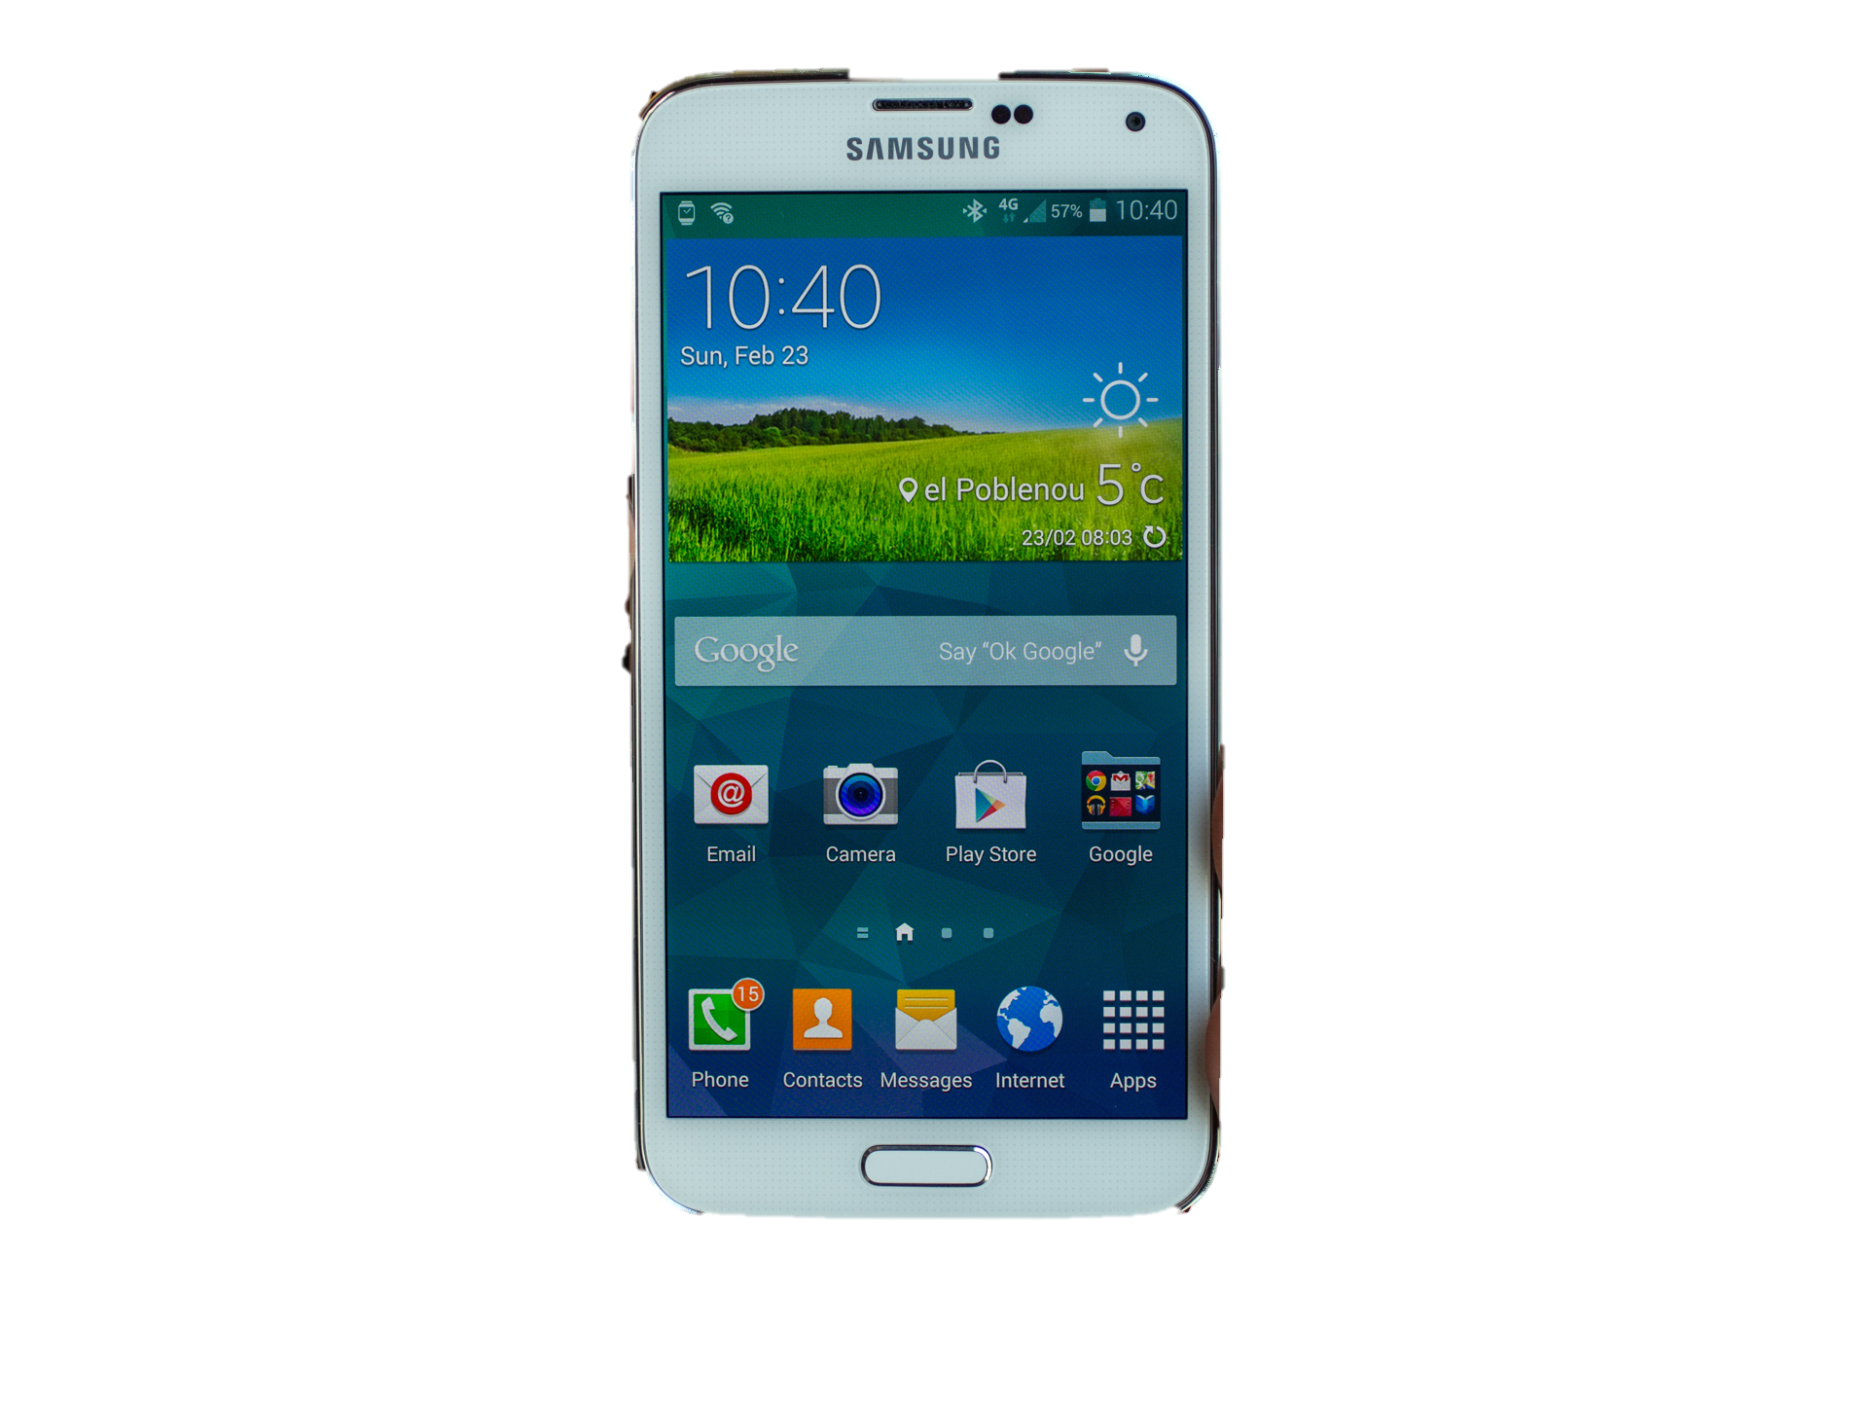
Mobile Data
People already carry phones
Can collect
Interactions with virtual information
Social engagement
Loads of sensors about physical actions

Slide 16
Sensors
Accelerometer
Applications
Battery
Bluetooth
Calls
Messaging
Gravity
Gyroscope
Light
Linear Accelerometer
Location
Magnetometer
Network Usage
Orientation
Pressure
Processor
Proximity
Rotation
Screen
Telephony
Temperature
Traffic
Wi-Fi
… many more

Slide 17
Big Data of 1
Build compelling and useful apps that provide value in everyday life and a compelling user experience
Think about what you can do with big data for 1 with origins in everyday activity
Notes:
Adaptive: accuracy, consistency of experience and interface, intelligibility: all problems we’re working on

Slide 18
Assumptions
We have made a number of WRONG assumptions about:
what smart phones are
how they are used
By removing assumptions, we can RE-CAST:
the notion of what a smart phone is
how to change usage behavior
how to perform behavioral imaging
how we can use them to improve people’s lives
how to leverage make (personalized) meaning from (your) big data
Notes:
We = the research community and now consumers

Slide 19
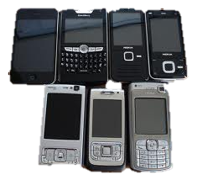
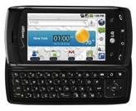
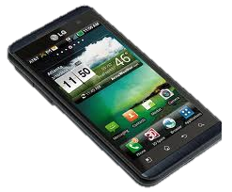
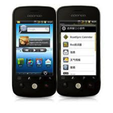
Assumption #1: We all have smart phones
What is a smart phone?
Android, iPhone, Nokia, Windows Mobile, Blackberry, …
Feature phone vs. smart phone
All Marketing
- “runs it’s own unique software but not a true and complete mobile OS”
- “runs a complete mobile OS”
- “offers more advanced computing ability and connectivity than a feature phone”

Slide 20
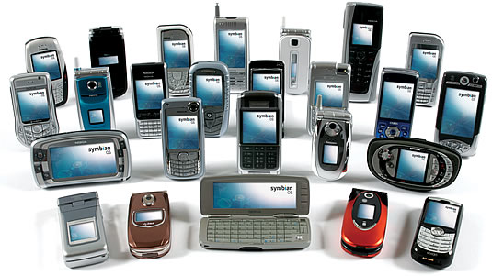
Dumb phones
We live in a time of dumb phones
Know almost nothing about me
Explicit preferences
Contacts
Running applications
Hardly knows when I’m mobile/fixed, charging/not charging
Doesn’t know me or what I’m doing
Why Not???

Slide 21
What we’d like instead: Context-aware phones
Input
User
System
Environment
Explicit
interaction
Implicit sensing
Application
Context-Aware
Application
Action
Action

Slide 22
Assumption #2: Usage
What do we know about how people use their mobile devices?
“Always on the phone!”
“Notifications are ruining my life!”

Slide 23
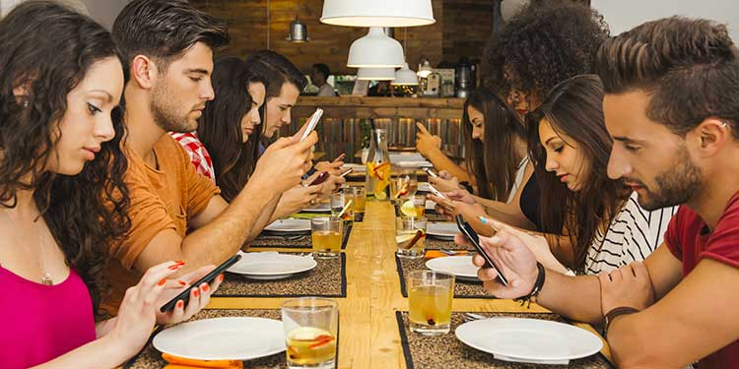
Assumption #2: Usage

Slide 24
Our iterative process
From Banovic et al. (2014)
Analysis & etc (not today’s focus)
Questions
Data Sets
New Questions
How much users use their phones?
How do users interact with their phones?
Can we predict when users use their phones?

Slide 25
Our iterative process
From Banovic et al. (2014)
Analysis & etc (not today’s focus)
Questions
Data Sets
New Questions
How much users use their phones?
A formative study with 10 participants for 1 month
How do users interact with their phones?
Can we predict when users use their phones?

Slide 26
Our iterative process
Analysis & etc (not today’s focus)
Questions
Data Sets
New Questions
How much users use their phones?
A formative study with 10 participants for 1 month
Visualization of usage trends
How do users interact with their phones?
Statistical analysis
Can we predict when users use their phones?

Slide 27
Our iterative process
From Banovic et al. (2014)
Analysis & etc (not today’s focus)
Questions
Data Sets
New Questions
How much users use their phones?
A formative study with 10 participants for 1 month
How can we streamline mobile device use?
How do users interact with their phones?
Can we predict when users use their phones?

Slide 28
Pause for a moment!
“How much users use their phones?”
Notes:
What is wrong with this question and how can we make it better?

Slide 29
Pause for a moment!
“How do users interact with their phones?”
Notes:
What is wrong with this question and how can we make it better?

Slide 30
Pause for a moment!
“Can we predict when users use their phones?”
Notes:
Discuss with your neighbour.

Slide 31
Real World Data Set
Notes:
Why should we do this type of research in a lab study?
Why not?

Slide 32
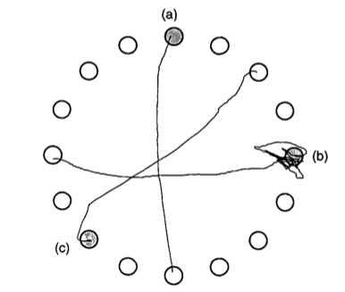
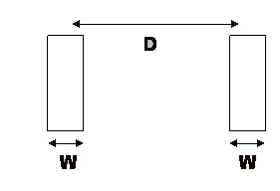
Laboratory Evaluation Limitations
Simulate real world environments
Location and equipment may be unfamiliar to participant [Coyne & Nielsen 2001]
Observation may effect performance - “Hawthorne Effect” [Mayo 1933]
Participant may become fatigued and not take necessary rest - “Demand Effect” [Orne 1962]
Tasks frequently artificial and repetitive, which may bore participants and negatively effect performance
Studying real world use removes these limitations
Notes:
We do laboratory stuff because… but it has its limitations
Automating a difficult task - means we don’t have to sit there and watch participants.

Slide 33
Why Study Real World Use?
Captures most realistic examples of mobile device usage
Collect large datasets from individuals by collecting data in the background
Usage may change over time

Slide 34
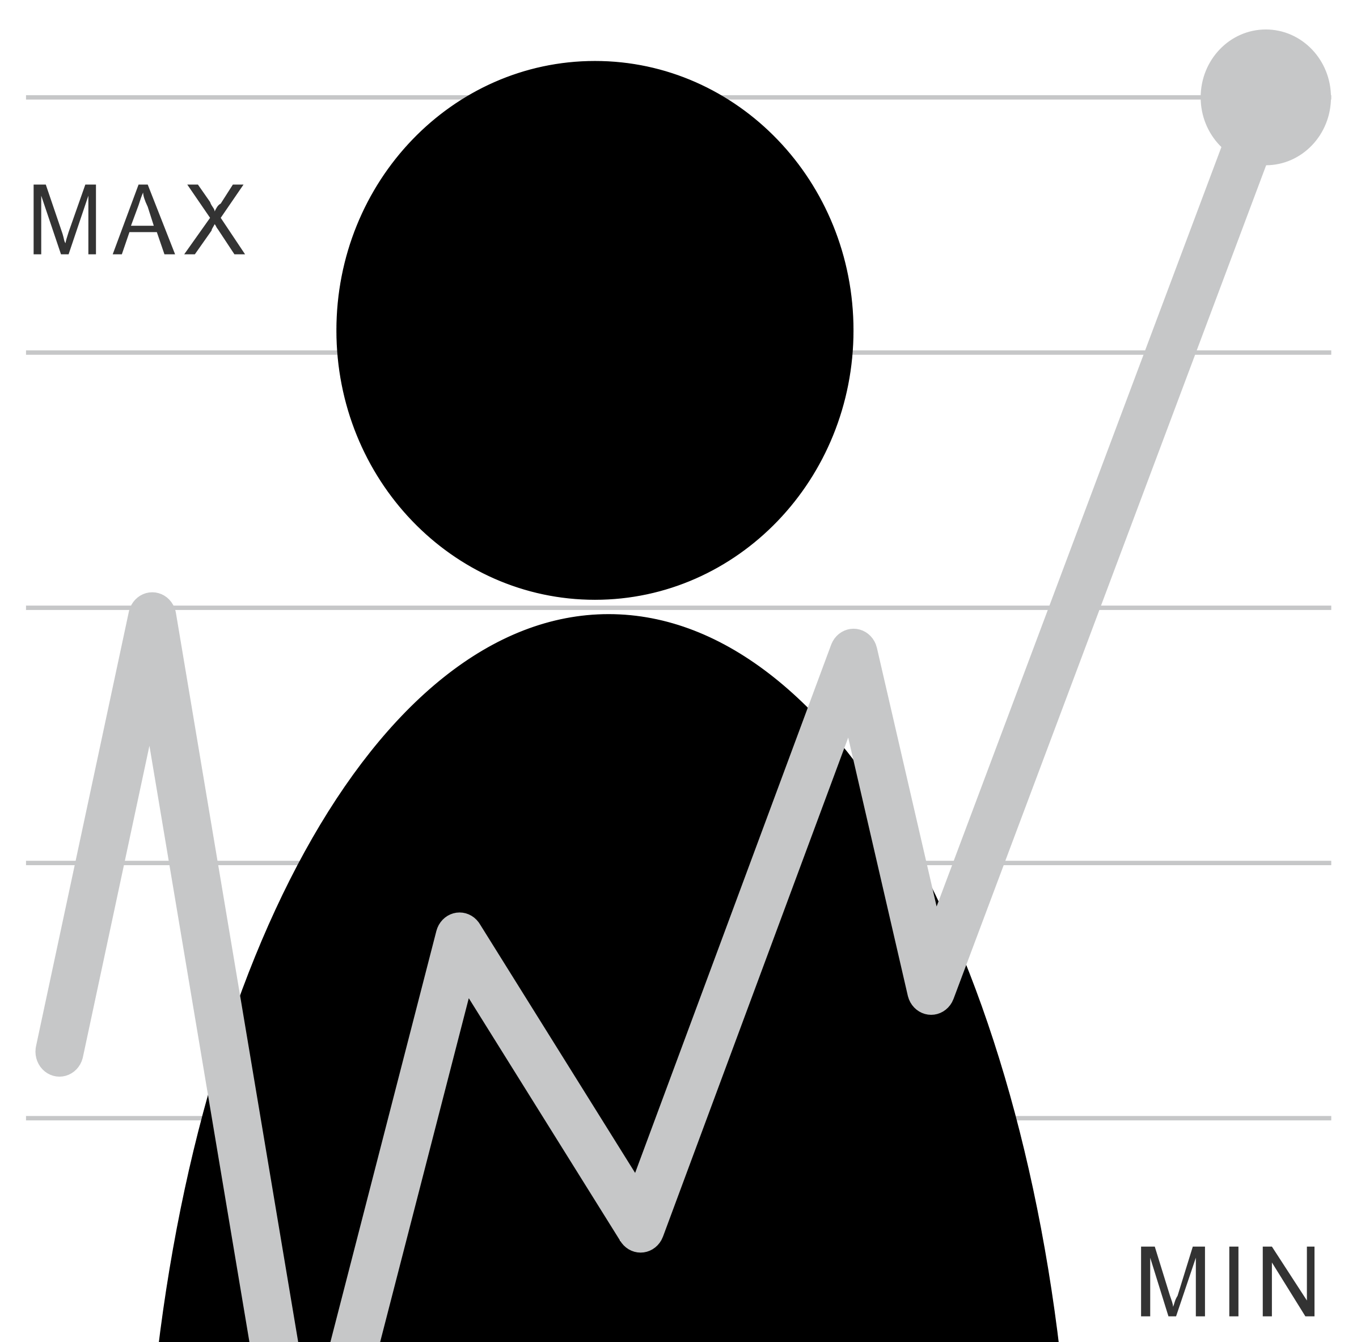
Human Issues in Data Collection
Recruitment
Attrition
Compliance
Untracked devices
What else?

Slide 35
Could we answer the first set of questions?

Slide 36
Question #1
How can we characterize mobile device usage based on duration and interaction type?

Slide 37
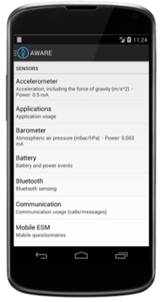
Formative Data Collection
Field Study
10 participants
1 month unobtrusive data collection

Slide 38
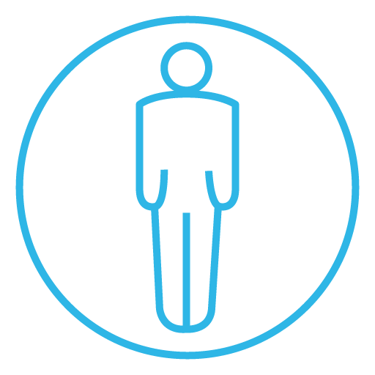
AWARE framework
Dey, Ferreira & Kostakos (Oulu)

Slide 39
Data Tables
Screen Status
Application Use
Notifications
Messaging & Phone Calls
Battery
Location
…

Slide 40
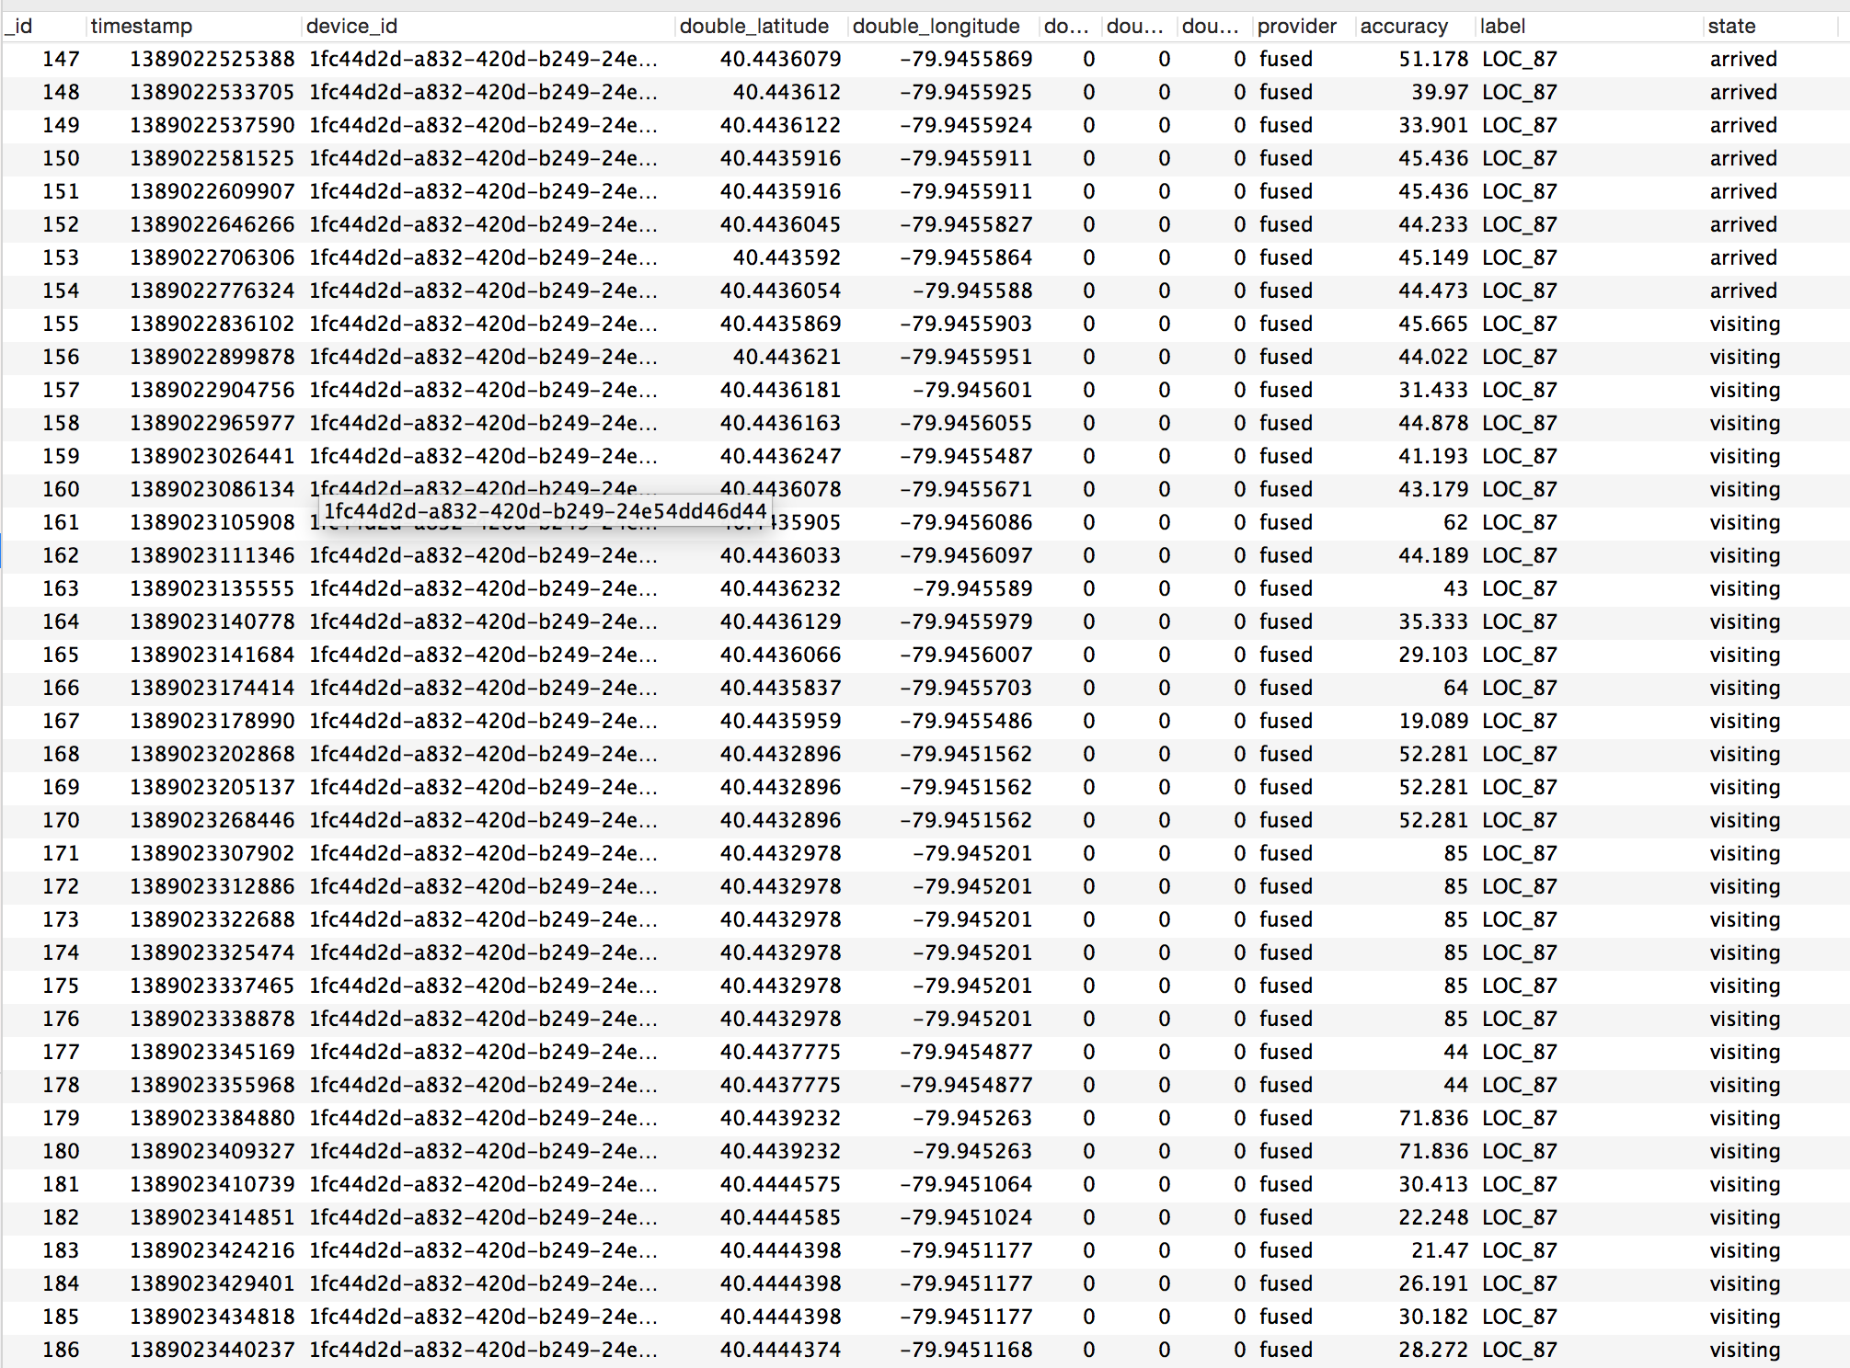
Unlike laboratory data,
real world data is not easily segmented or clustered
Notes:
Analyzing real world data is more complicated than analyzing laboratory data. One reason is that laboratory log data is typically “segmented” by task (or intent) which is usually clear because the experimenter tells the participant what to do. However, when studying real world data, we do not know the user’s tasks and the only information we have to work with are long logs of event data.
Since we don’t know intent, we segment data according to events captured by CRUMBS that are relevant to the assessments we want to make. In this thesis we focus on targeting motions, so we segment data by button events and pauses.

Slide 41
Notes:
Analyzing real world data is more complicated than analyzing laboratory data. One reason is that laboratory log data is typically “segmented” by task (or intent) which is usually clear because the experimenter tells the participant what to do. However, when studying real world data, we do not know the user’s tasks and the only information we have to work with are long logs of event data.
Since we don’t know intent, we segment data according to events captured by CRUMBS that are relevant to the assessments we want to make. In this thesis we focus on targeting motions, so we segment data by button events and pauses.

Slide 42
Analysis Details: Defining a Session
A usage session is defined from the time the user turns the screen on, until the time the screen is off.
What about automatic screen timeouts?
Simple heuristic: Group all sessions that are less than 5 seconds apart into the same session.
Can we classify which interactions belong in the same session? [van Berkel et al., 2016]

Slide 43
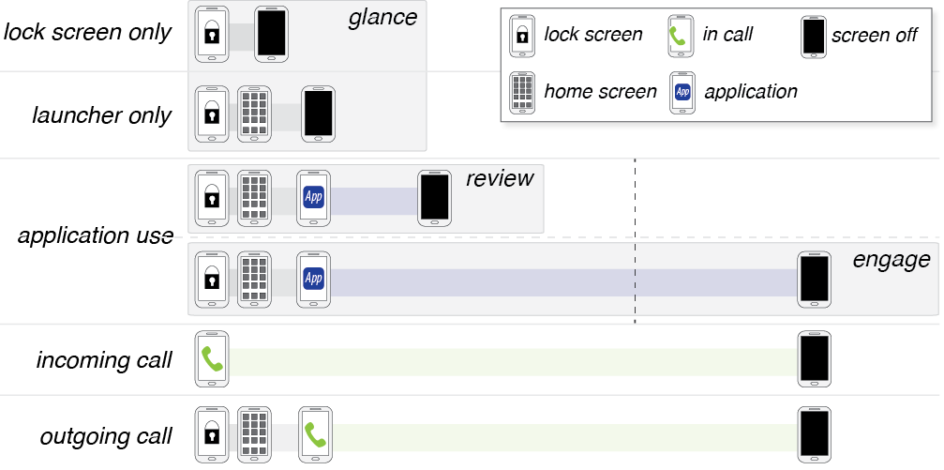
Characterizing Usage

Slide 44
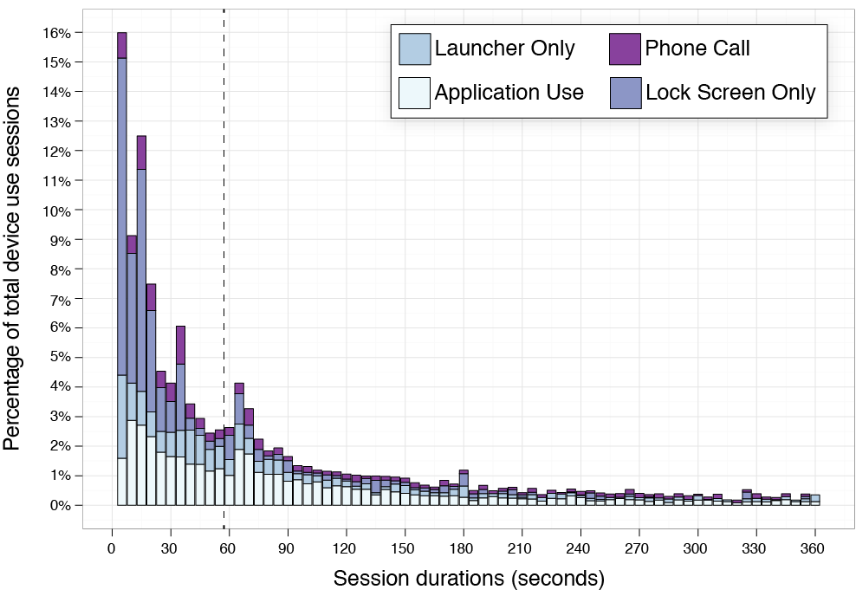
Characterizing Usage

Slide 45
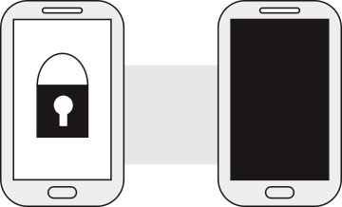
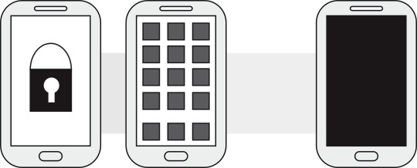
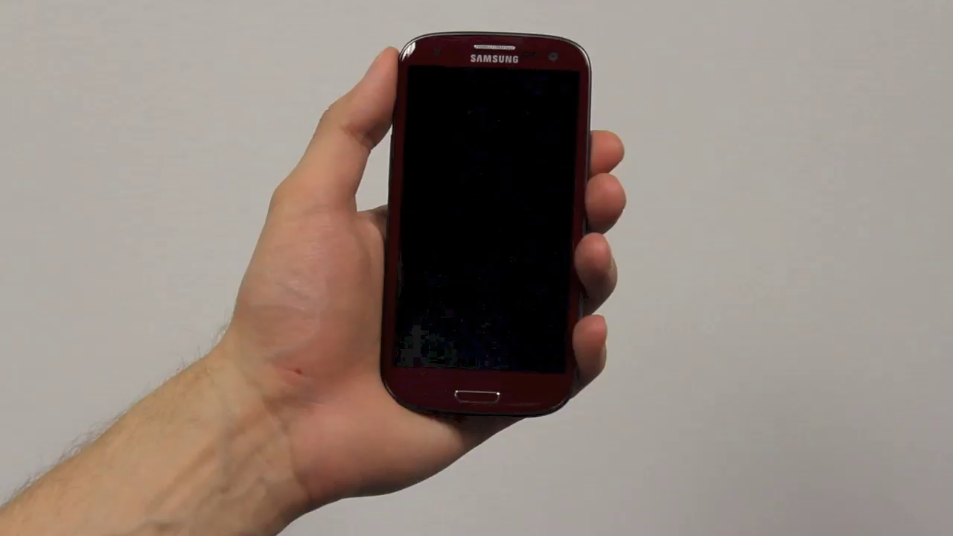
GLANCE
Notes:
We define, glances where the user turns on the screen, looks at the widgets on the lock screen and turns the screen off. Or alternatively, unlocks the screen but only looks at the notifications or widgets on the home screen.

Slide 46
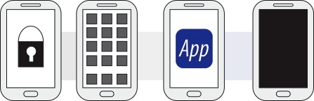
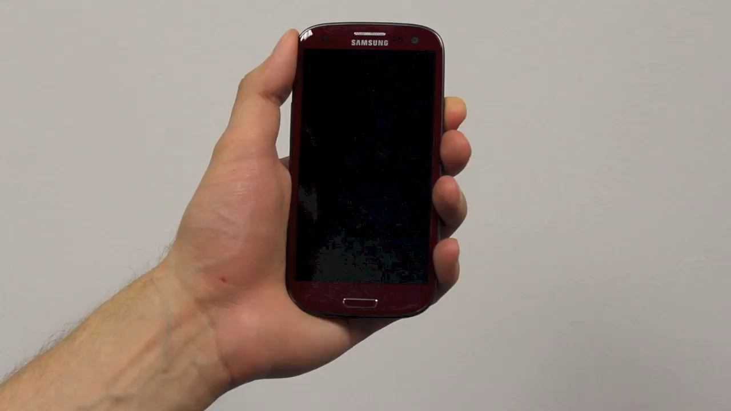
REVIEW
Notes:
Reviews, in which the user unlocks the phone and invokes one or more applications and uses these applications for less than 60 seconds. For example the user might review a text message and even respond to it quickly.

Slide 47
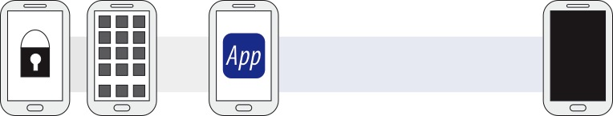
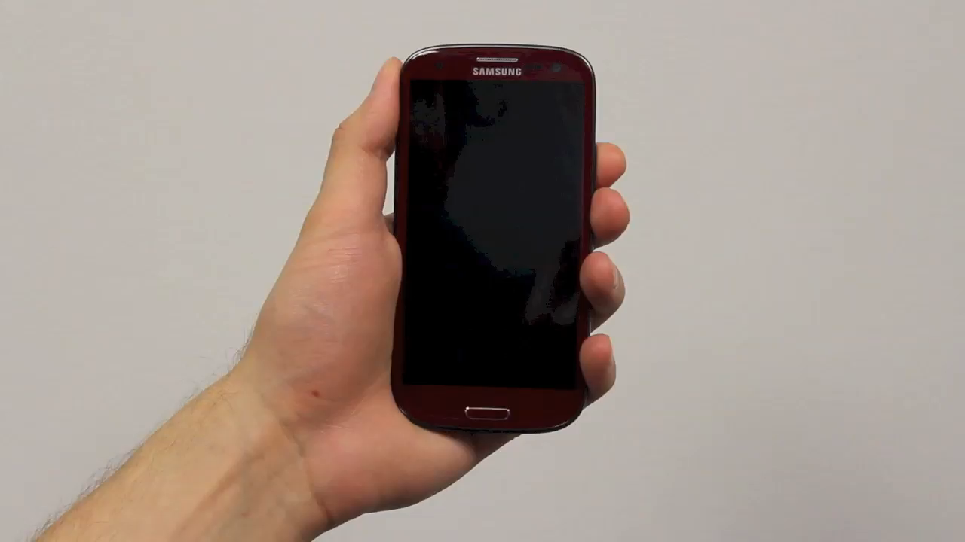
ENGAGE
Notes:
And engages, in which the user invokes one or more applications and interacts with them for longer than 60 seconds. For example, the user might engage in reading news and then watching movies on youtube.

Slide 48
Summary of Preliminary Findings
95% of sessions shorter than 5 minutes; most < 60 secs
Notifications lead to engagement… only 25% of the time!
Self-interruption therefore more common than we would think
Notifications prevent unnecessary engages
No good support for reviews

Slide 49
Our iterative process
Questions
Data Sets
New Questions
How much users use their phones?
A formative study with 10 participants for 1 month
How do users interact with their phones?
Can we predict when users use their phones?

Slide 50
Predicting Usage
Can we predict when and where participants are likely to review their devices?

Slide 51
Our iterative process
Questions
Data Sets
New Questions
How much users use their phones?
A formative study with 10 participants for 1 month
How can we streamline mobile device use?
How do users interact with their phones?
Can we predict when users use their phones?
Notes:
Can we answer the new question with the old data?

Slide 52
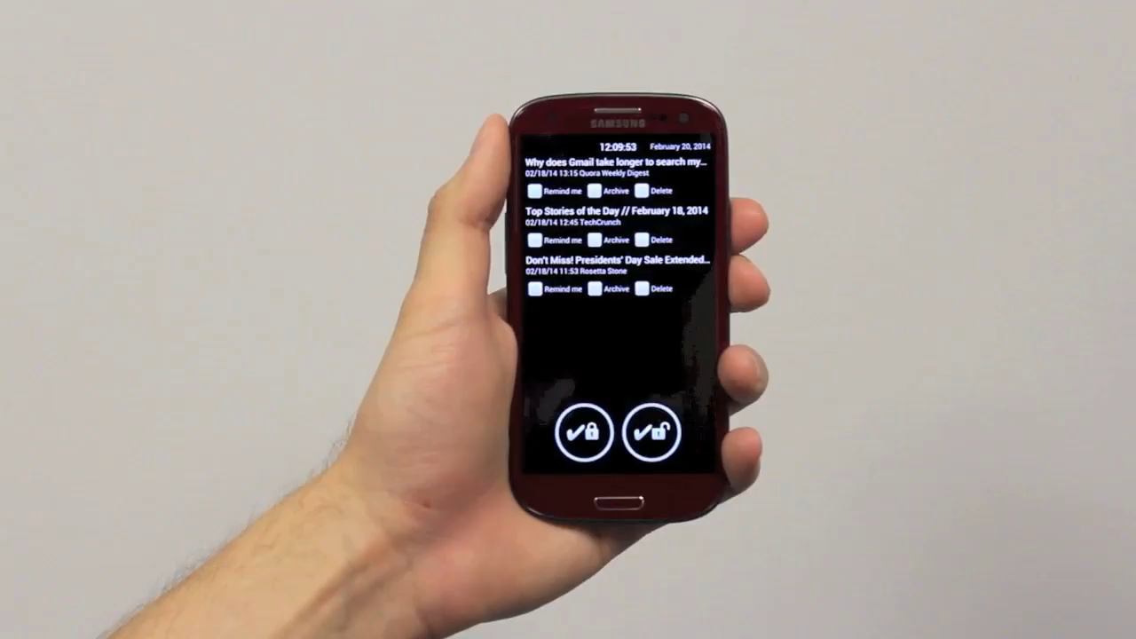

Slide 53
Data Collection
Field Study
30 participants
1 month (actually exactly 4 weeks) data collection
3 participants did exactly what we told them not to do

Slide 54
Our iterative process
Questions
Data Sets
New Questions
Data Sets
How much users use their phones?
A formative study with 10 participants for 1 month
How can we streamline mobile device use?
A field user study with 30 participants for 1 month
How do users interact with their phones?
Can we predict when users use their phones?

Slide 55
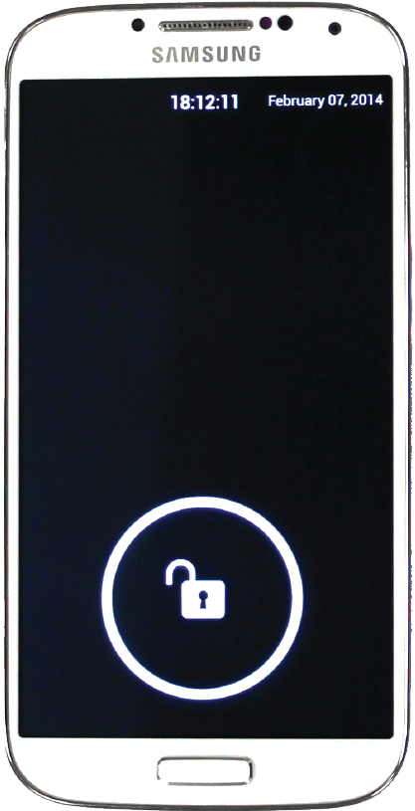
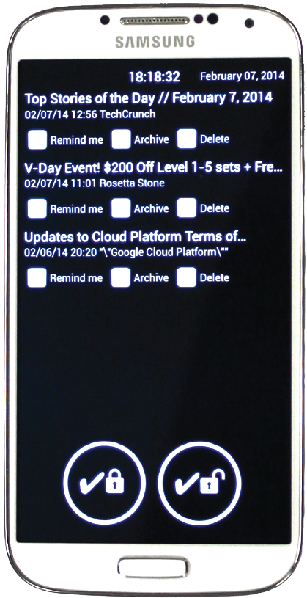

Slide 56
How frequently do users interact with ProactiveTasks?
Notes:
We were interested whether users would actually perform the tasks on the lock screen.

Slide 57
Overall use frequency
100%
75%
sessions with tasks
50%
25%
14.99%
7.12%
6.44%
0%
1
2
3
4
week
Notes:
So here we see the mean percentage of sessions with tasks where participants applied actions to emails. Overall, we see that participants found some use for proactive tasks. But we wanted to dig deeper, and see if there is difference in how participants interacted with the prototype.

Slide 58
Non-users (10 participants)
100%
75%
sessions with tasks
50%
25%
3.85%
0.00%
0.00%
0%
1
2
3
4
week
example non-user (P1)
Notes:
We found non users who used the lock screen a few times during the first week when tasks showed up, but the novelty then wore off and they did not interact with it in the remaining weeks. When we asked them about their use, they simply said that they had no use for the actions on the lock screen or prefer to engage with the email application.

Slide 59
Regular users (9 participants)
100%
75%
sessions with tasks
50%
25%
7.41%
9.26%
5.41%
0%
1
2
3
4
week
example regular user (P21)
Notes:
We also found regular users that interacted with the prototype throughout the 3 weeks. They said that they mostly used the tasks when they had some down time, or when bored or nothing better to do. Which is what we expected ProactiveTasks will be helpful for.

Slide 60
Power users (5 participants)
100%
75%
52.54%
47.73%
sessions with tasks
44.62%
50%
25%
0%
1
2
3
4
week
example power user (P19)
Notes:
However, we also found power users who applied actions to email in more than 1/3 of sessions when tasks were present on their lock screen.
They had a lot of emails piled up in their inboxes and also received a lot of emails. So they found proactive tasks helpful to manage their inboxes.

Slide 61
Cleaner users (3 participants)
100%
75%
sessions with tasks
50.00%
50%
38.89%
25%
21.43%
0%
1
2
3
4
week
example cleaner user (P10)
Notes:
We also found a special kind of power users called cleaners. They rarely had any unread emails in their inbox and used ProactiveTasks to keep their inbox clear of any unwanted emails.

Slide 62
Our iterative process
Questions
Data Sets
New Questions
Data Sets
How much users use their phones?
A formative study with 10 participants for 1 month
How can we streamline mobile device use?
A field user study with 30 participants for 1 month
How do users interact with their phones?
Can we predict when users use their phones?

Slide 63
New Questions?

Slide 64
Our iterative process
Questions
Data Sets
New Questions
How much users use their phones?
A formative study with 10 participants for 1 month
Are there different user types?
Can we predict when users are interruptible?
How do users interact with their phones?
Can we predict intent?
Can we predict next task?
A field user study with 30 participants for 1 month
How can we streamline mobile device use?
How do users interact with wearables?
Can we model mobile usage routines?

Slide 65
Our iterative process
Questions
Data Sets
New Questions
How much users use their phones?
A formative study with 10 participants for 1 month
Are there different user types?
Can we predict when users are interruptible?
How do users interact with their phones?
Can we predict intent?
Can we predict next task?
A field user study with 30 participants for 1 month
How can we streamline mobile device use?
How do users interact with wearables?
Can we model mobile usage routines?

Slide 66
Our iterative process
Questions
Data Sets
New Questions
How much users use their phones?
A formative study with 10 participants for 1 month
Are there different user types?
Can we predict when users are interruptible?
How do users interact with their phones?
Can we predict intent?
Can we predict next task?
A field user study with 30 participants for 1 month
How can we streamline mobile device use?
How do users interact with wearables?
Can we model mobile usage routines?

Slide 67
Key observations
There are human aspects to collecting and understanding the data
Iteration is key
Having a question/motivation/intuition informs data collection
Your thoughts?

Slide 68
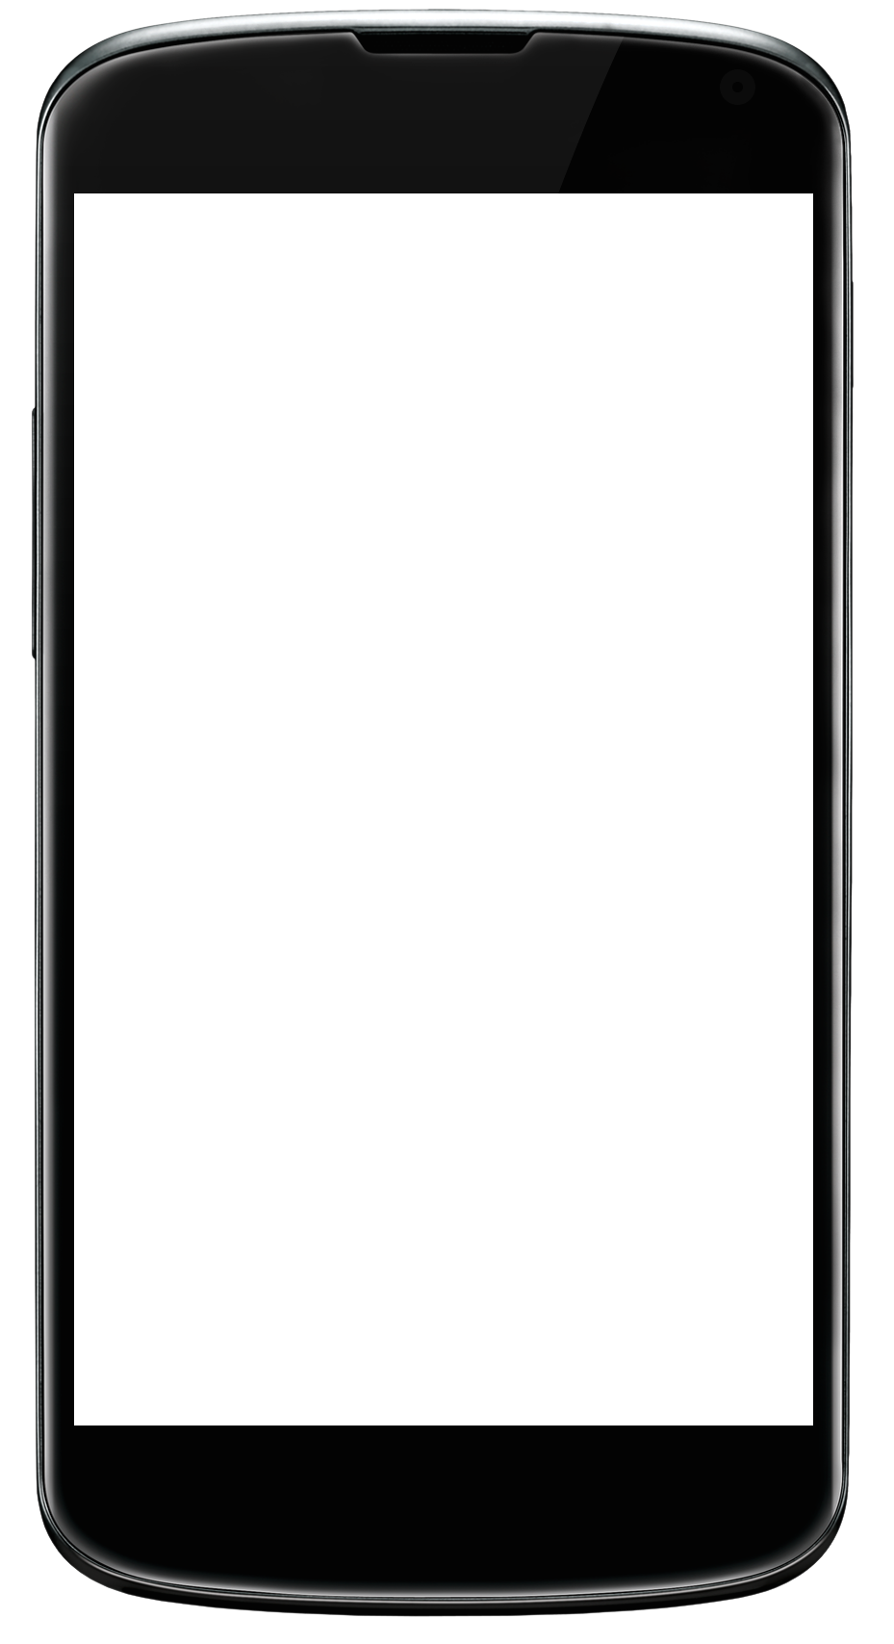
Phone-stression: quantifying someone’s frustrations when using their smartphones
Measurements:
Network problems/Network use
App crashes/App use
Screen adjustments/abuse
Light sensor/Pressure
Tapping frequency/Shaking
Repeated swipes to refresh
Accelerometer
Location not working
What frustrates you on your phone?
Notes:
Example project…

Slide 69
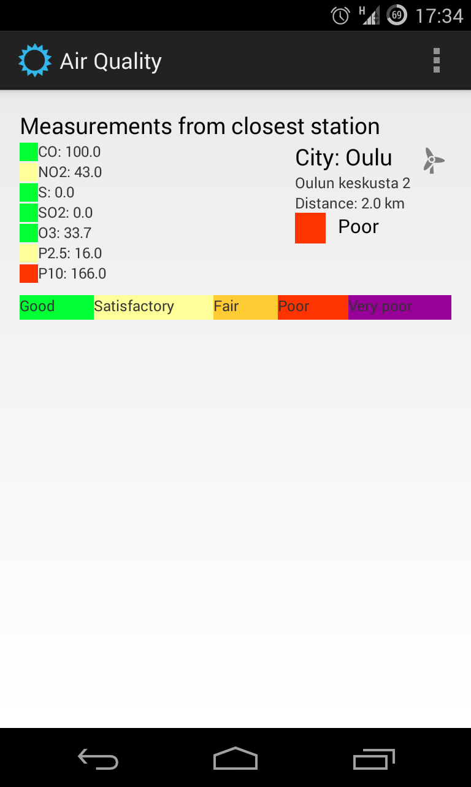
Asthma: weather, air quality, mobility and symptoms
Mood over time
Daily physical activity
Mobility range
Air quality exposure
Weather exposure
Asthma symptoms

Slide 70
Exercise: Twitter
Very popular, lots of data
What questions can you ask?

Slide 71
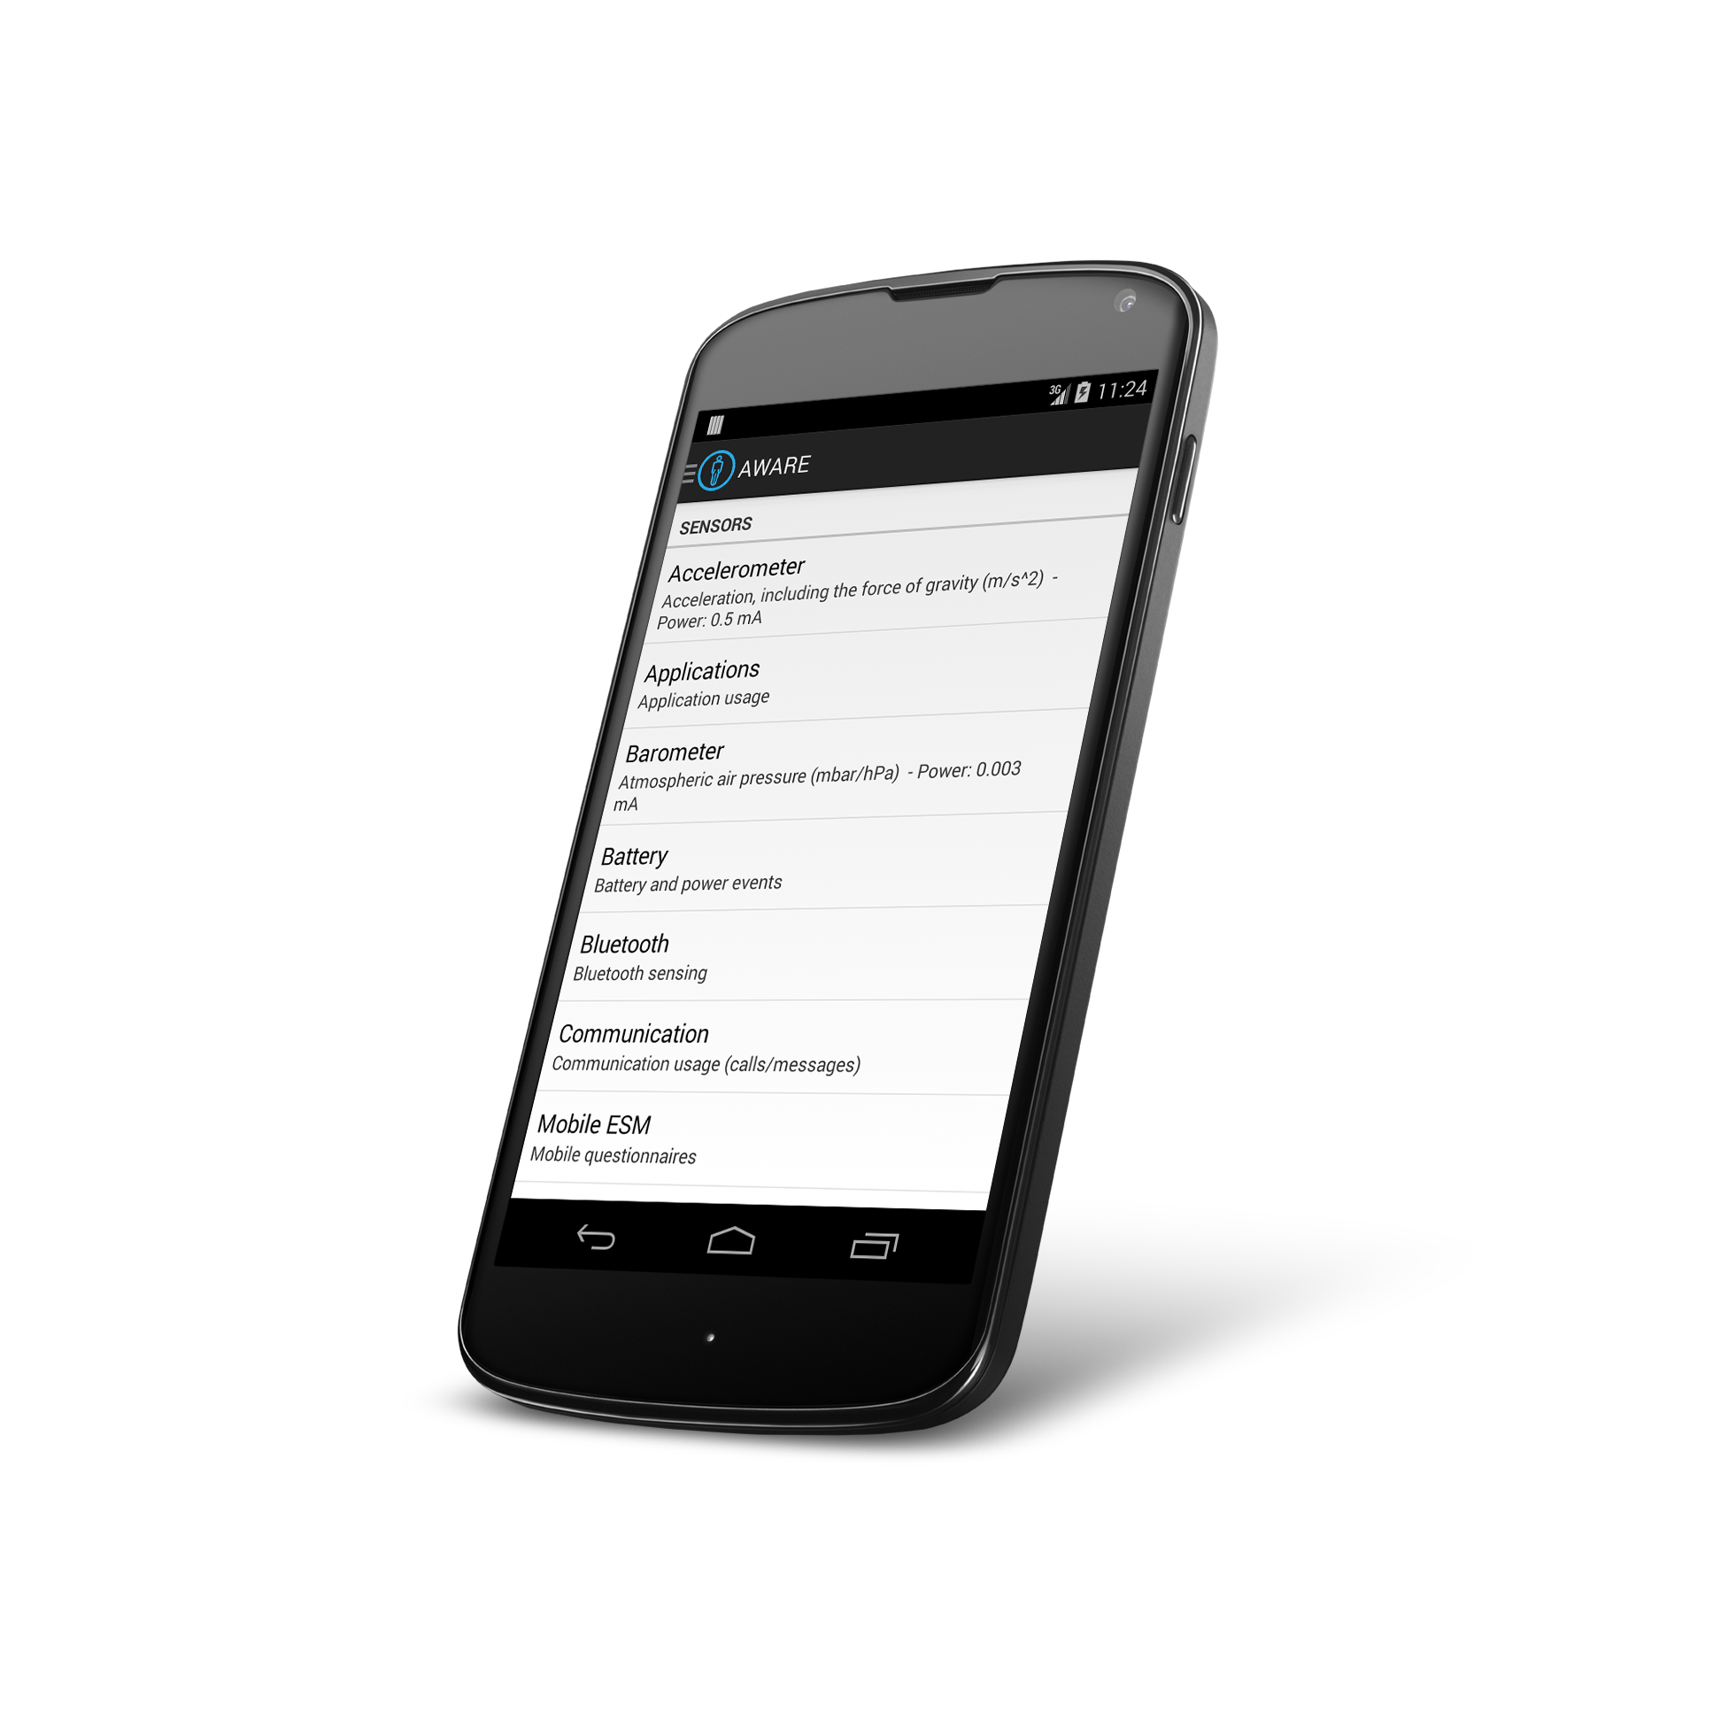
Aware Framework Dey, Ferreira & Kostakos (Oulu)
awareframework.com Collaborative mobile sensing for understanding human behavior and social wellbeing
Developer
Scientist
User
Notes:
You will use it, so let’s talk about it…

Slide 72
Overview
awareframework.com
User
Scientist
Developer

Slide 73
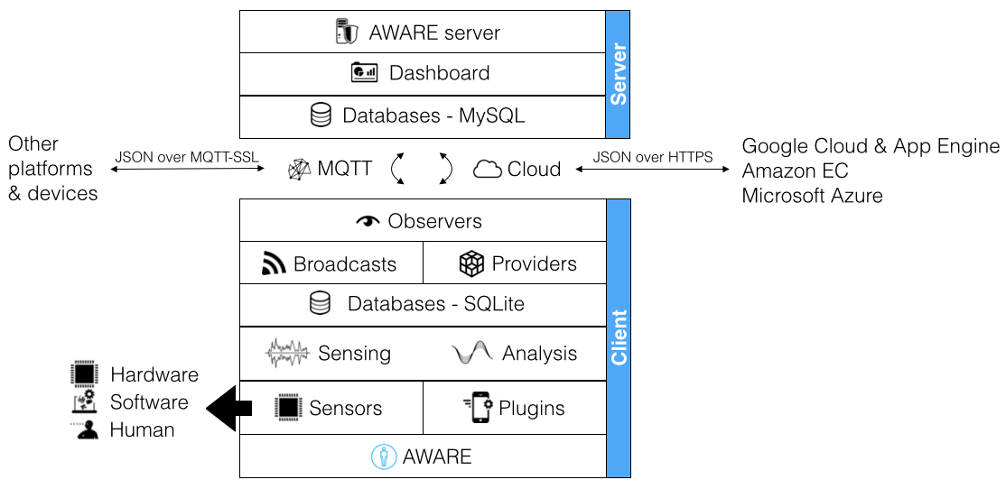
Architecture

Slide 74
Aware Sensors
GPS
Bluetooth
Battery
Wi-fi access point info
Cellular network info
Network traffic
Strategies for extending battery life: 12 hours
Accelerometer
Installed apps, running apps
Audio settings
Screen settings
Call/text/email/calendar logs
…
Notes:
Freely available to use: built

Slide 75
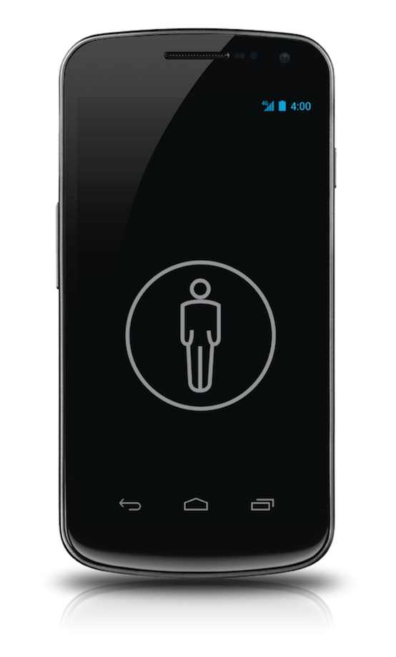


Plugins help with data interpretation:
Diet tracking
application
Accelerometer
Calorie counter
(plugin)
Step counter
(plugin)
Activity Recognition
(plugin)
noisy data
Mobility
application
REUSABILITY is the key here!

Slide 76
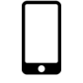

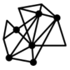


Ways to use AWARE
Dashboard
M2M
Databases
Large-scale, distributed studies, or personal studies:
AWARE-hosted or self-hosted databases
Concurrent studies
Study-specific or public plugins
Specify study’s active sensors
Enroll participants via a QRCode or a direct URL
Monitor the study’s status (e.g., amount of data, participation)
Remotely design and trigger mobile questionnaires (ESMs)

Slide 77
Reminder
Byte 1 due Monday 1/23
Byte 3 install due Tuesday 1/24

